Slide 1
تمرین ششم مدار منطقی

Slide 2
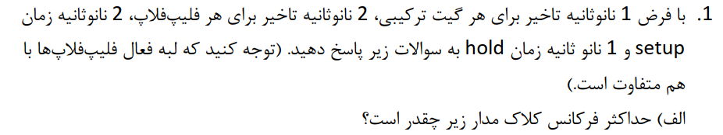
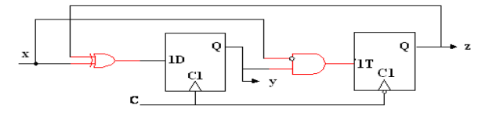



Slide 3
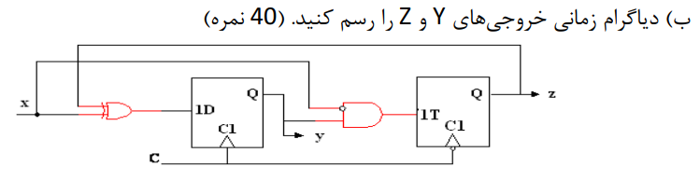
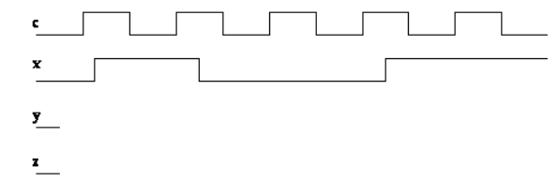

Slide 4
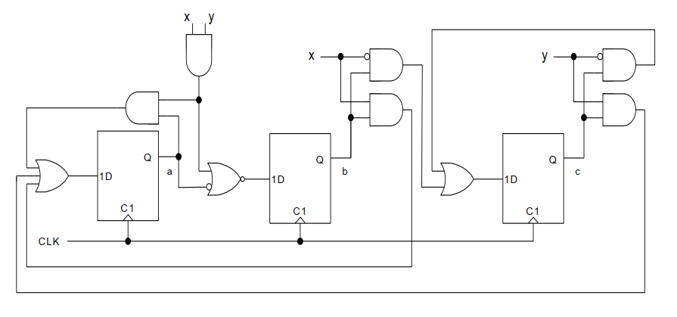

Slide 5








A(t) | B(t) | C(t) | X(t) | Y(t) | A(t+1) | B(t+1) | C(t+1)
0 | 0 | 1 | 0 | 0 | 0 | 0 | 1
0 | 0 | 1 | 0 | 1 | 1 | 0 | 0
0 | 0 | 1 | 1 | 0 | 0 | 0 | 1
0 | 0 | 1 | 1 | 1 | 1 | 0 | 0
0 | 1 | 0 | 0 | 0 | 0 | 0 | 1
0 | 1 | 0 | 0 | 1 | 0 | 0 | 1
0 | 1 | 0 | 1 | 0 | 1 | 0 | 0
0 | 1 | 0 | 1 | 1 | 1 | 0 | 0
1 | 0 | 0 | 0 | 0 | 0 | 1 | 0
1 | 0 | 0 | 0 | 1 | 0 | 1 | 0
1 | 0 | 0 | 1 | 0 | 0 | 1 | 0
1 | 0 | 0 | 1 | 1 | 1 | 0 | 0

Slide 6

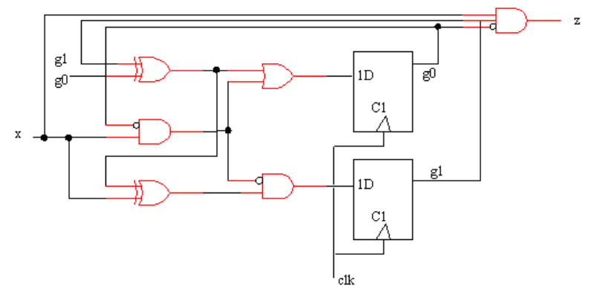
g0(t) | g1(t) | x(t) | g0(t+1) | g1(t+1) | z(t)
0 | 0 | 0 | 0 | 0 | 0
0 | 0 | 1 | 1 | 0 | 0
0 | 1 | 0 | 1 | 1 | 0
0 | 1 | 1 | 1 | 0 | 1
1 | 0 | 0 | 1 | 1 | 0
1 | 0 | 1 | 1 | 0 | 0
1 | 1 | 0 | 0 | 0 | 0
1 | 1 | 1 | 0 | 1 | 0

Slide 7


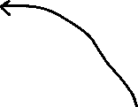


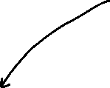

Slide 8
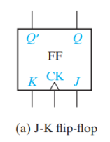
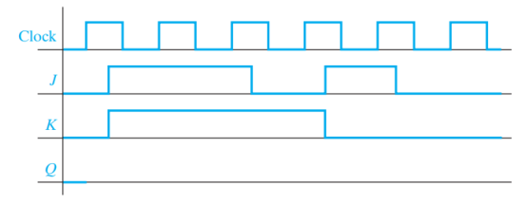

Slide 9
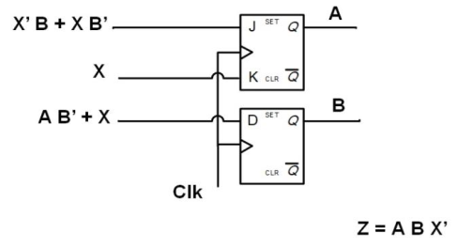
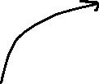
A(t) | B(t) | X(t) | J1(t) | D(t) | A(t+1) | B(t+1) | Z(t)
0 | 0 | 0 | 0 | 0 | 0 | 0 | 0
0 | 0 | 1 | 1 | 1 | 1 | 1 | 0
0 | 1 | 0 | 1 | 0 | 1 | 0 | 0
0 | 1 | 1 | 0 | 1 | 0 | 1 | 0
1 | 0 | 0 | 0 | 1 | 1 | 1 | 0
1 | 0 | 1 | 1 | 1 | 0 | 1 | 0
1 | 1 | 0 | 1 | 0 | 1 | 0 | 1
1 | 1 | 1 | 0 | 1 | 0 | 1 | 0

Slide 10
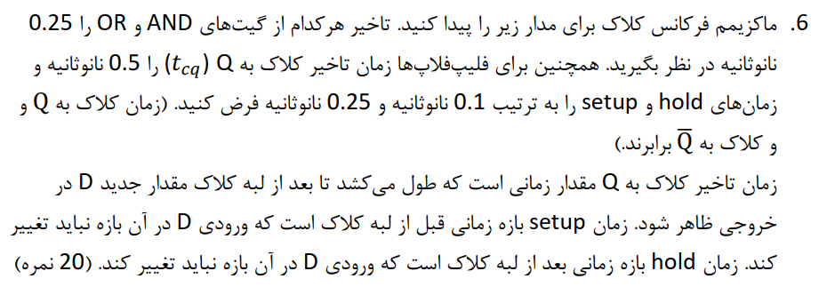
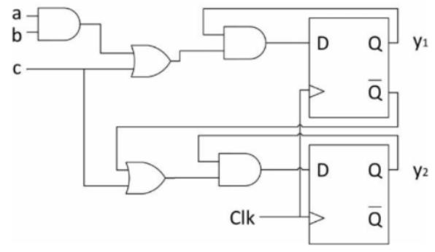
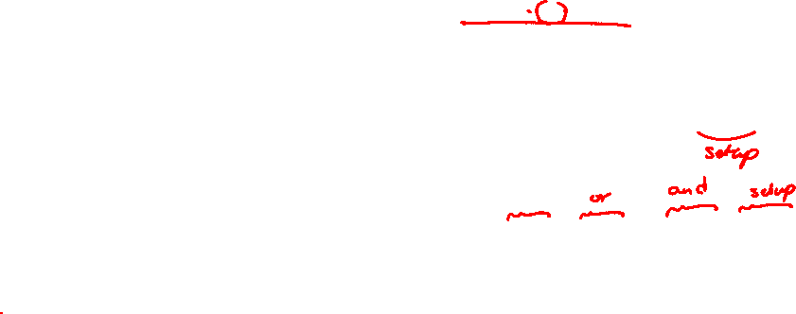



Slide 11
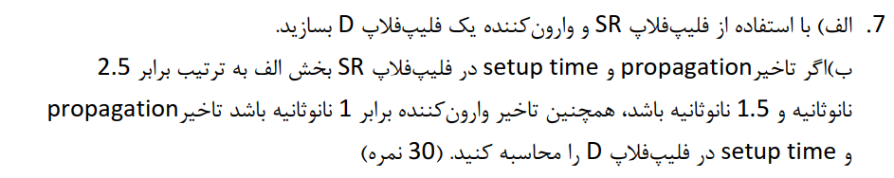

Slide 12
